Slide 1
UNIT I
Frame and div tag in html

Slide 2

Frames
HTML frames are used to divide your browser window into multiple sections where each section can load a separate HTML document.
A collection of frames in the browser window is known as a frameset. The window is divided into frames in a similar way the tables are organized: into rows and columns.
Creating Frames
To use frames on a page we use <frameset> tag instead of <body> tag.
The <frameset> tag defines, how to divide the window into frames.
The rows attribute of <frameset> tag defines horizontal frames and cols attribute defines vertical frames.
Each frame is indicated by <frame> tag and it defines which HTML document shall open into the frame.

Slide 3
Disadvantages of Frames
Some smaller devices cannot cope with frames often because their screen is not big enough to be divided up.
Sometimes your page will be displayed differently on different computers due to different screen resolution.
The browser's back button might not work as the user hopes.
There are still few browsers that do not support frame technology.

Slide 4
Creating Frames
To use frames on a page we use <frameset> tag instead of <body> tag.
The <frameset> tag defines, how to divide the window into frames.
The rows attribute of <frameset> tag defines horizontal frames and cols attribute defines vertical frames.
Each frame is indicated by <frame> tag and it defines which HTML document shall open into the frame.

Slide 5
The example to create three horizontal frames
<frameset rows = "10%,80%,10%">
<frame name = "top" src = "/html/top_frame.htm" />
<frame name = "main" src = "/html/main_frame.htm" />
<frame name = "bottom" src = "/html/bottom_frame.htm" />
<noframes>
<body>Your browser does not support frames.</body>
</noframes>
</frameset>

Slide 6
Example
<frameset cols = "25%,50%,25%">
<frame name = "left" src = "/html/top_frame.htm" />
<frame name = "center" src = "/html/main_frame.htm" />
<frame name = "right" src = "/html/bottom_frame.htm" />
<noframes>
<body>Your browser does not support frames.</body>
</noframes>
</frameset>

Slide 7
Question
What will happen if you fail to follow a "best practice"?
The computer will complain
The browser will loudly complain
Experienced developers will complain
The browser will quietly complain

Slide 8
Question
Which of the following is not used to create a Web page?
A simple text editor
An advanced HTML aware editor
A Fortran compiler
A gui based tool

Slide 9
The <frameset> Tag Attributes
Cols
Rows
Border
Frameborder
framespacing

Slide 10
The <frame> Tag Attributes
Src
Name
Frameborder
Marginwidth
Marginheight
Norsize
Scrolling
longdesc

Slide 11
Frame's name and target attributes
<frameset cols = "200, *">
<frame src = "/html/menu.htm" name = "menu_page" />
<frame src = "/html/main.htm" name = "main_page" />
<noframes>
<body>Your browser does not support frames.</body>
</noframes>
</frameset>

Slide 12
Define a frameset with two columns:
<FRAMESET COLS="*,*">
<FRAME SRC="leftmost.html" NAME=left>
<FRAME NAME=right>
</FRAMESET>
left | Right

Slide 13
Cont…
Top Right
Bottom Right
<FRAMESET ROWS="25%,75%">
<FRAME SRC="top.html" NAME=topright>
<FRAME SRC="bottom.html" NAME=bottomright>
</FRAMESET>
<FRAMESET COLS="*,*">
<FRAME SRC="leftmost.html" NAME=left>
<FRAMESET ROWS="25%,75%">
<FRAME SRC="top.html" NAME=topright>
<FRAME SRC="bottom.html" NAME=bottomright>
</FRAMESET>
</FRAMESET>
Left | Top
 | Bottom

Slide 14
Question
Which amongst the following is the attribute that is used to add styles to an element in HTML such as color, font, and so on?
Dir
Style
Color
None of the above

Slide 15
HTML tag <iframe>
The <iframe> tag is not somehow related to <frameset> tag, instead, it can appear anywhere in your document.
The <iframe> tag defines a rectangular region within the document in which the browser can display a separate document, including scrollbars and borders.
An inline frame is used to embed another document within the current HTML document.
The src attribute is used to specify the URL of the document that occupies the inline frame.
Example program:
<body>
<p>Document content goes here...</p>
<iframe src = "/html/menu.htm" width = "555" height = "200">
Sorry your browser does not support inline frames.
</iframe>
<p>Document content also go here...</p>
</body>

Slide 16
Question
What is <iframe> tag used for?
To display a web page within a web page.
To specify an inline frame.
Both (a) and (b)
None of the above

Slide 17
Question
Select the correct syntax.
A)<iframe src="iframe.htm" width="200" height="200"> </iframe>
B) <frame src="iframe.htm" width="200" height="200">
C) <iframe src="iframe.htm" width="200" height="200">
D) None of the above

Slide 18
HTML div tag
HTML <div> tag is used to divide the web page into different divisions or parts. The <div> tag basically acts as a container for other HTML elements.
The <div> tag is used for grouping the HTML elements into sections on a webpage.
You can also apply CSS(cascading Style sheets) to the elements that are grouped using the <div> tag.
The <div> tag should not be used inside <p> tag, although you can use it inside the paragraph tag, if in a paragraph you want to divide the content into different parts.
Also, this is a block-level element.
The <div> tag is a tag which has no specific styling of its own other than display:block; because it is block level element, which means two <div> tags will not be displayed inline,

Slide 19
HTML <div> Tag - Syntax and Usage
It requires both opening tag (<div>) as well as closing tag(</div>).
Syntax
<div>
…… Content here……
</div>

Slide 20
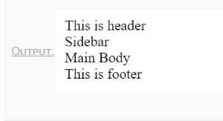
Example program
<div class="header">This is header</div>
<div class="body">
<div class="sidebar">Sidebar</div>
<div class="main-body">Main Body</div>
</div>
<div class="footer">This is footer</div>

Slide 21
Example program
<!DOCTYPE>
<html>
<body>
<div style="border:1px solid pink;padding:20px;font-size:20px">
<p>Welcome to Javatpoint.com, Here you get tutorials on latest technologies.</p>
<p>This is second paragraph</p>
</div>
</body>
</html>

Slide 22
Difference between HTML div tag and span tag
div tag | span tag
HTML div is a block element. | HTML span is an inline element
HTML div element is used to wrap large sections of elements. | HTML span element is used to wrap small portion of texts, image etc.

Slide 23
HTML <div> Tag Attributes
Attributes
id
Class
style

Slide 24
Question
Can we use div tag in form tag?
A) True
B) Flase

Slide 25
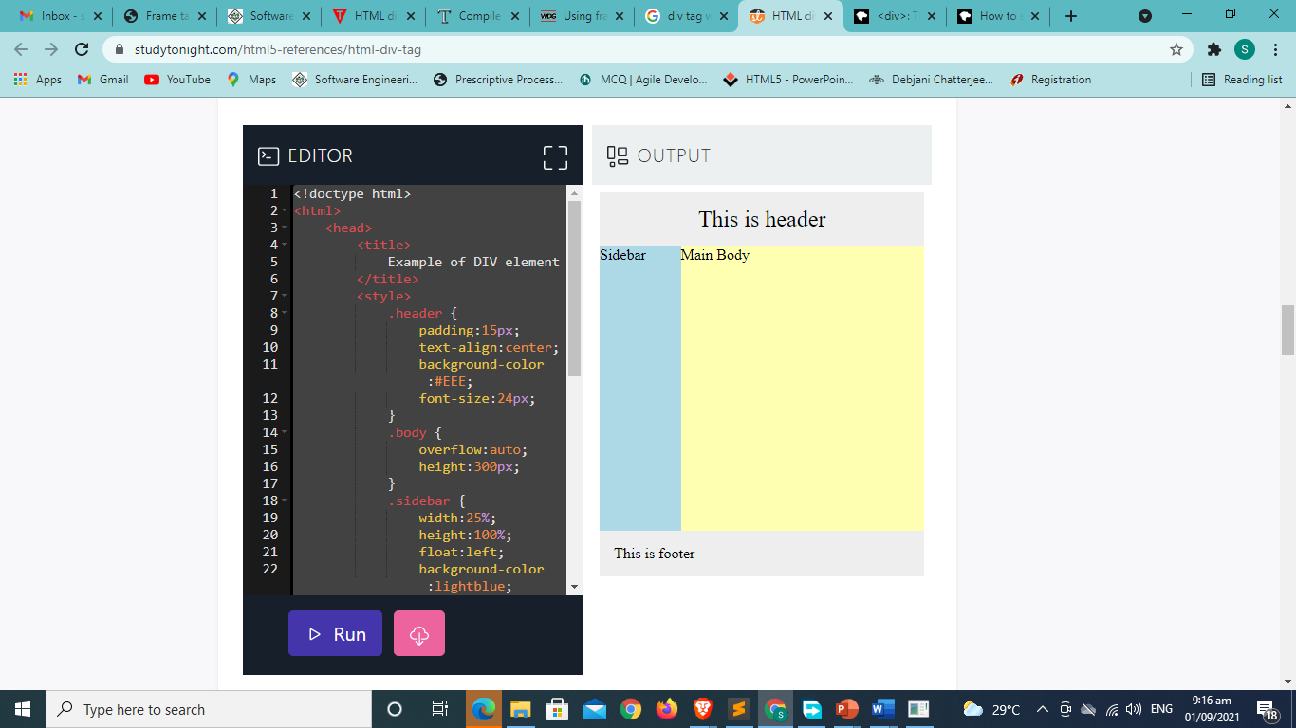
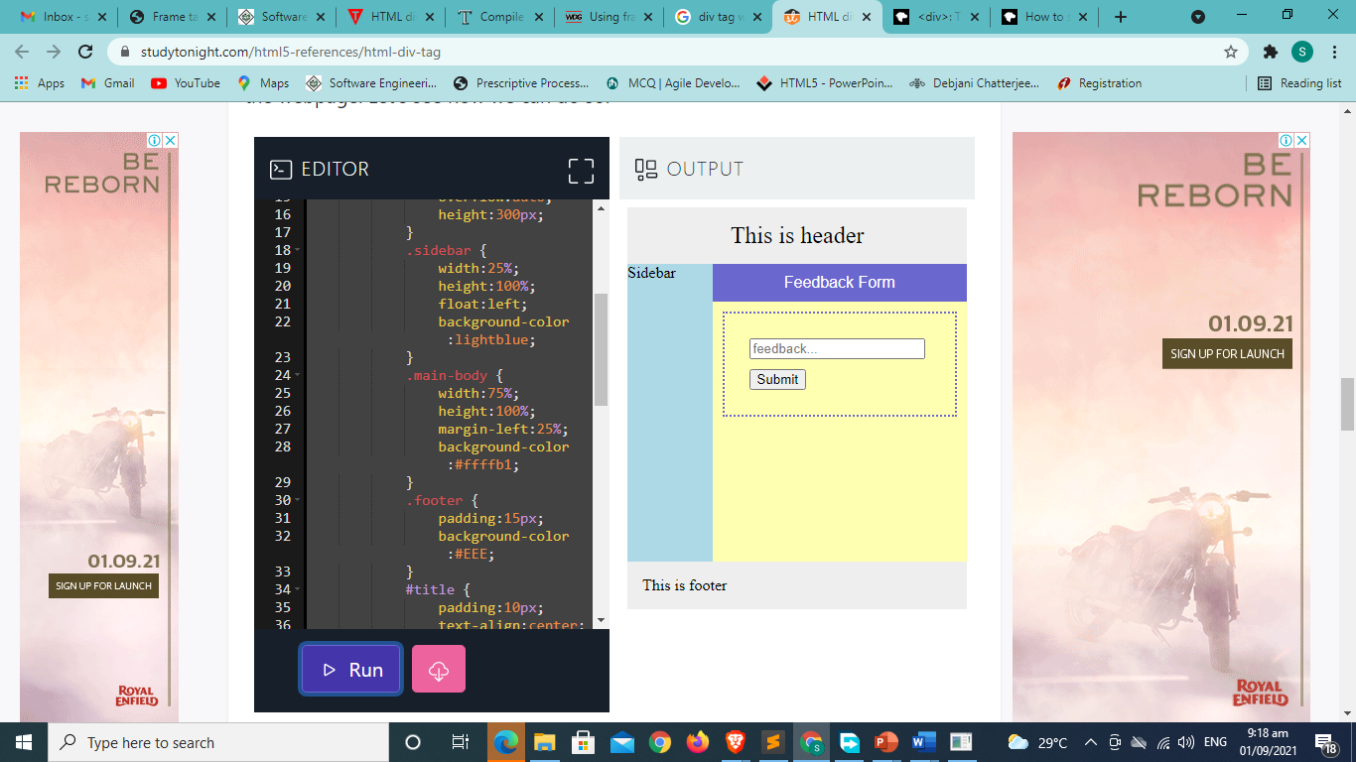
What will be the code?

Slide 26
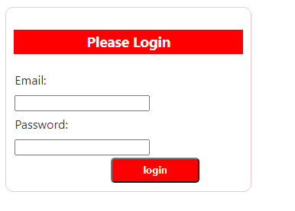
HTML div example: Login Form

